Slide 1



INFINITE
DELIVERY SERVICE SYSTEM

Slide 2

INTRODUCTION
In the modern economy, delivery services are essential due to the growth of e-commerce and on-demand services.
As a project, developing a delivery service system enables us to work on a solution that has real-world applications.
User interfaces for both clients and delivery staff are part of a delivery service system.
This provides the chance to focus on the customer experience, making sure the system is simple touse, satisﬁes the needs of many clients, and is user-friendly.

Slide 3

CLASSES
1.USER CLASS
2.CUSTOMER CLASS
3.ORDER CLASS
4.COURIER CLASS
5.CHARGE CLASS
6.PAYMENT METHOD CLASS
7.MAIN CLASS
1. *User Class*:
Attributes:
- username: Stores the username of the user.
- password: Stores the password of the user.
Functions:
- Constructor to initialise username and password.
- Method to authenticate the user based on entered username
and password.
CLASSES
2. *Customer Class* (inherits from User):
Attributes:
- Inherits username and password from the User class.
- name: Stores the name of the customer.
- address: Stores the address of the customer.
- mobileNumber: Stores the mobile number of the customer.
Functions:
-Constructor to initialise customer data.
- Getter methods for name, address, and mobile Number.

Slide 4
3. *Order Class*:
Attributes:
- orderNumber: Stores the order number.
- itemName: Stores the name of the item in the order.
- itemDetails: Stores details about the item.
- quantity: Stores the quantity of the item.
- deliveryPersonName: Stores the name of the delivery person.
- deliveryAddress: Stores the delivery address.
- deliveryPersonContact: Stores the contact number of the delivery person.
Functions:
- Constructor to initialise order details.
- Getter methods for various attributes.
4. *Courier Class*:
Attributes:
- name: Stores the name of the courier person.
- id: Stores the ID of the courier person.
- contactNumber: Stores the contact number of the courier person.
Functions:
- Constructor to initialise courier details.
- Getter methods for attributes.

Slide 5


5. *Charge Class*:
Attributes:
- Constants for various charges like BASE_CHARGE, MINIMUM_WEIGHT_CHARGE, etc.
- distances: Array storing distances to Colpetty for each town.
Functions:
- Calculates the delivery charge based on weight and distance.
6. *PaymentMethod Class*:
Attributes:
- method: Stores the payment method.
Functions:
-Constructor to initialize payment method.
- Getter and setter methods for method.

Slide 6

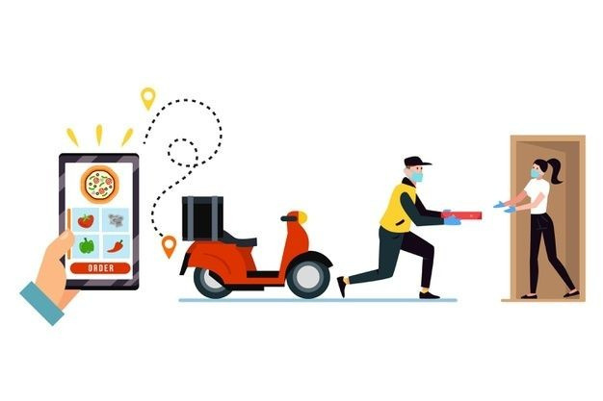
7. *Main Class*:
- Contains the main method to run the program.
- Handles user interaction through console input.
- Contains methods to handle customer ordering, order placement, courier selection, charge calculation, and payment process.
CUSTOMERS

Slide 7
OOP PRINCIPLES USED TO DEVELOP THE SYSTEM
Encapsulation:
In our system, encapsulation serves as a powerful tool for organizing and securing our data.
The classes User, Customer, Order, Courier, Charge, and PaymentMethod employ private instance variables, shielding their internal details.
Through carefully crafted public methods, known as getters and setters, we provide controlled access to these variables.
This encapsulation strategy not only enhances data security but also fosters a clean and manageable interface for interacting with our objects.
By encapsulating the intricacies within our classes, we improve code maintainability and minimize the risk of unintended interference.

Slide 8
Inheritance:
Building upon the foundation of encapsulation, our system leverages the concept of inheritance.
Specifically, the Customer class extends the User class, establishing an "is-a" relationship, signifying that a customer is a type of user.
This elegant mechanism promotes code reuse by allowing the Customer class to inherit the properties and methods of the
User class while still maintaining its distinct attributes and functionalities.
Inheritance enhances our codebase's scalability and maintainability by avoiding redundancy and encouraging a modular approach to design.

Slide 9
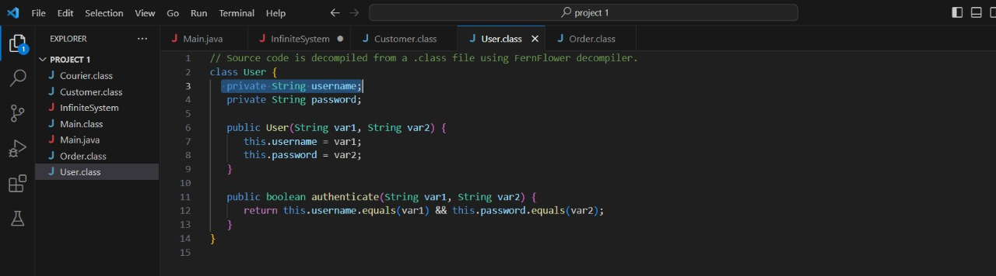
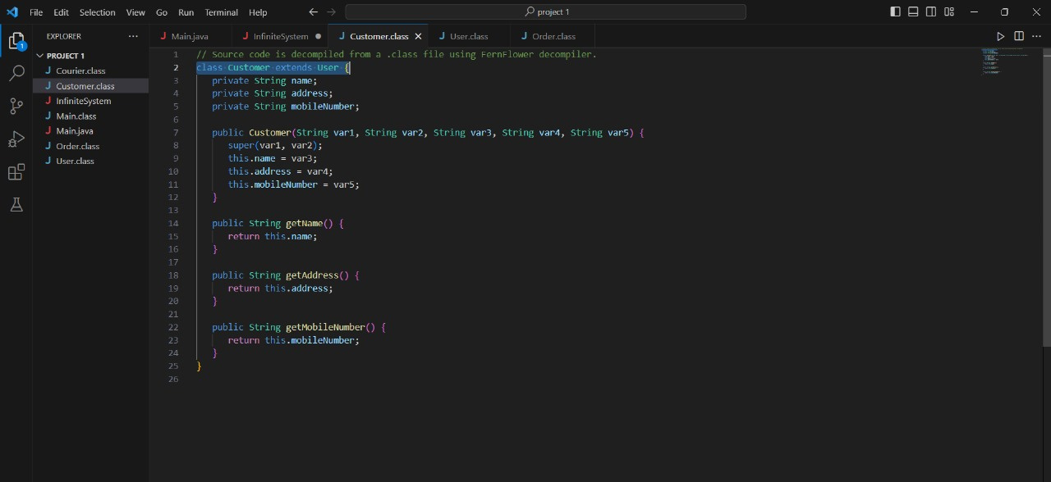

Slide 10
MODIFICATIONS
Instead of using a hardcoded array for usernames and passwords, consider implementing a more secure authentication mechanism. A database allows for better management of user information and provides a more robust and secure authentication process.
Implement a proper payment processing system with third-party APIs or libraries for handling real transactions. Real-world applications require secure and reliable payment processing.
Enhance the user interface with clear prompts, instructions, and a more user-friendly design. Improving the user interface enhances the overall user experience and makes the system more accessible and user-friendly.
Implement security measures such as input validation, secure communication, and authorization to protect against common security threats. Security is crucial in online systems.

Slide 11

CHALLENGES OBSERVED
Challenge: Handling concurrent access and data consistency.
Solution: Implement proper synchronization mechanisms or consider using a database management system that handles concurrent access.
Challenge: Testing the system thoroughly.
Solution: Implement a comprehensive testing strategy, including unit tests, integration tests, and system tests, to identify and resolve potential issues.
Challenge: Ensuring system scalability.
Solution: Design the system with scalability in mind, such as using modular and efficient algorithms and considering potential bottlenecks.

Slide 12


TEAM WORK
The project has been distributed among a team of 5 individuals to ensure
efﬁcient collaboration and timely completion.
The list of works assumed for each persons like;
★ C.Prinshiga - Assigned to write programs for the customer,order
classes.
★ V.Mathivany - Reserved to develop code for the courier class.
★ A.Siboshan - Distributed delivery class to write coding.
★ S.Ganamoorthy - Allowed to develop the payment and delivery status classes.
★ T.Chankavi-Allocated to design coding for the delivery service part and to overall troubleshooting

